Slide 1
Incentives
Turkey's Investment Incentives System

Slide 2
Turkey's Investment Incentives System
Effective as of January 1, 2012, the new investment incentives system is comprised of four different schemes. Local and foreign investors have equal access to:
1- General Investment Incentives Scheme
2- Regional Investment Incentives Scheme
3- Large-Scale Investment Incentives Scheme
4- Strategic Investment Incentives Scheme

Slide 3
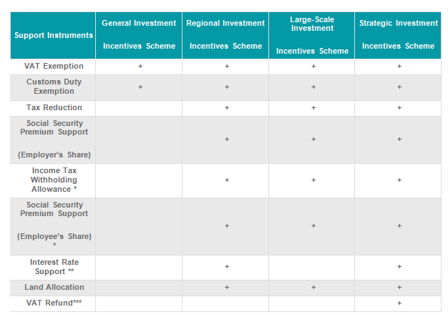
Turkey's Investment Incentives System
The support instruments to be provided within the framework of various investment incentives schemes are shown in the following table:

Slide 4
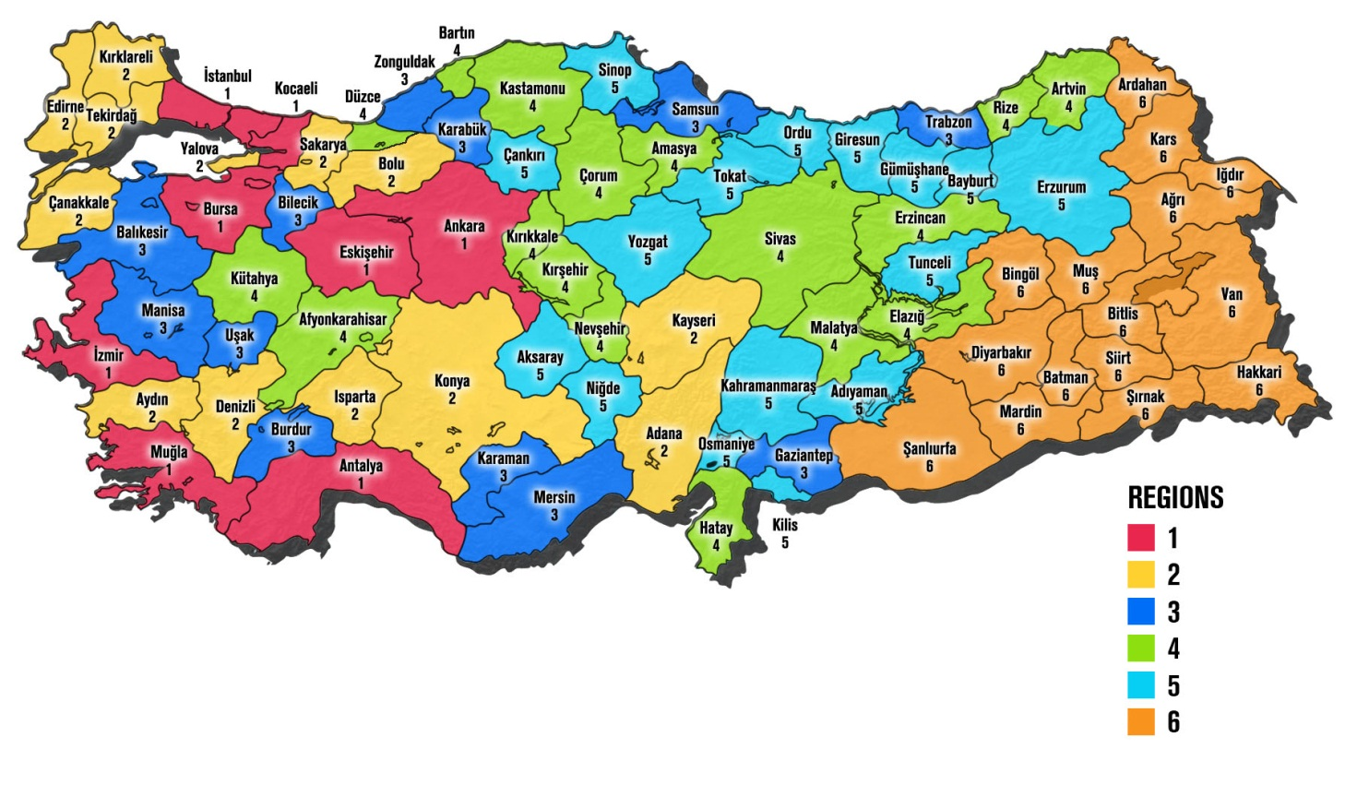
Turkey's Investment Incentives System
The Incentives Region

Slide 5
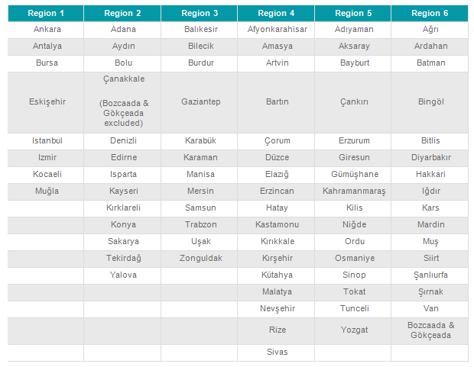
Turkey's Investment Incentives System
Investment Incentives Region – the table of which city in which region

Slide 6
Turkey's Investment Incentives System
1- General Investment Incentives Scheme
Regardless of the region where investment takes place, all projects meeting both the specific capacity conditions and the minimum fixed investment amount are supported within the framework of the General Investment Incentives Scheme. Some types of investments are excluded from the investment incentives system and would not benefit from this scheme.
The minimum fixed investment amount is TRY 1 million in Region 1 and 2, and TRY 500,000 in Region 3, 4, 5 and 6.

Slide 7
Turkey's Investment Incentives System
Major investment incentive instruments are:
1) Exemption from customs duties
2) VAT exemption
3- Regional Investment Incentives Scheme
4- Large-Scale Investment Incentives Scheme
5- Strategic Investment Incentives Scheme

Slide 8
Turkey's Investment Incentives System
Support Instruments
1) VAT Exemption
2) Customs Duty Exemption
3) Tax Reduction
4- Social Security Premium Support (Employee’s Share)
5- Social Security Premium Support (Employer’s Share)

Slide 9
Turkey's Investment Incentives System
Support Instruments
6) Income Tax Withholding Allowance
7) Interest Rate Support
8) Land Allocation
9) VAT Refund

